Slide 1



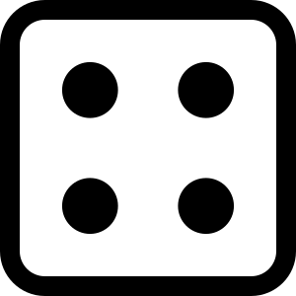


Roll a Sight Word
Practise your sight words in the boxes below.
the
and
but
so
he
she

